Slide 1




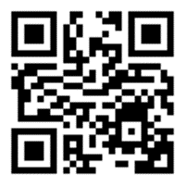
CommUNITYten
The Big Ten Academic Alliance
Women in Medicine and Biomedical Science Conference
Register Today
Early Bird Registration Ends December 31, 2023
June 7-8, 2024
The Ohio Union
1739 N. High Street
Columbus, OH 43210
About the Event
A conference designed to lift and empower women in academic medicine and biomedical science through sharing resources, professional development, education and connection.
Please Click Here, use QR code to right; or visit https://cvent.me/LNQdvB to access the registration and conference agenda
For more information or to sponsor, contact The Ohio State University Women in Medicine and Science at WIMS@osumc.edu

