Slide 1
Purdue Excellence in Research Administration (PERA)
2023-2024

Slide 2
What is PERA?
PERA represents Purdue’s first fully integrated research administration system and will replace a variety of independently configured research administration systems.
PERA is Purdue’s name for the Huron Research Suite, a next-generation system that automates processes required to apply for research grants, manage research funding, and apply to regulatory committees that oversee research with human subjects, vertebrate animals, biohazards, and other compliance matters.

Slide 3
PERA Expectations
“PERA will take us to the next level of sophistication and efficiency in research administration by streamlining and integrating how we operate. PERA will also save researchers time on administrative matters, allowing them to focus more attention on their work.”
Mung Chiang, Purdue University President

Slide 4
PERA Benefits
These are just a few of the improvements to expect:
Unified platform for managing and monitoring research projects
Enhanced transparency for the Purdue research community
Automated research administration business processes
Dashboard with centralized and consolidated information
Automated workflow, routing, approvals and communication

Slide 5
PERA Timeline

Slide 6
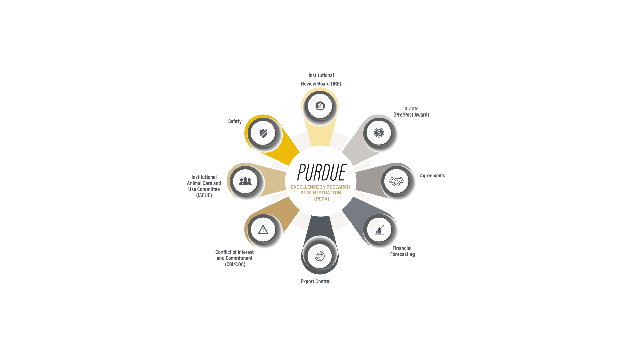
PERA Modules
PERA’s first four modules to go live in October 2024 will address the following areas:
Grants (pre/post award)
Agreements
Financial Forecasting
Institutional Animal Care and Use Committee (IACUC)
By October 2025, these modules will be added:
Export Control
Safety Institutional Biosafety Committee (IBC)
Conflict of Interest (COI)
Conflict of Commitment (COC)
Institutional Review Board (IRB)

Slide 7
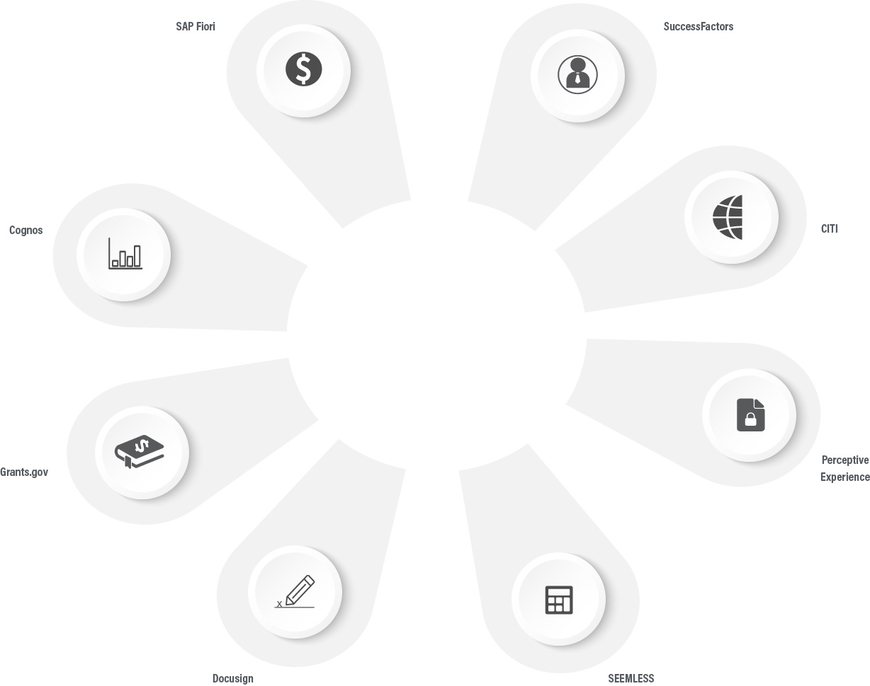
Communication update
PERA Module (Purdue applications)

Slide 8
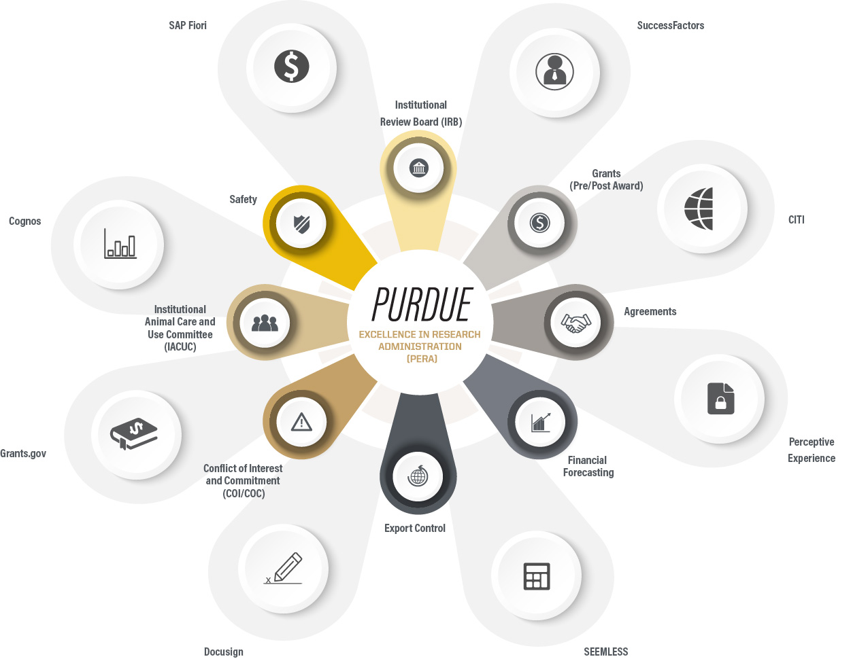
Communication update
PERA Module (Phase 2)

Slide 9
PERA Website
Faculty and staff can access the most recent PERA information via a PERA website that features timely updates and tools such as a PERA fact sheet, slides, and frequently asked questions.
https://research.purdue.edu/pera

Slide 10
PERA Project Organizational Chart
Executive Sponsors
Executive Steering Committee
Project Sponsors & Module Owners
Project Director & Managers
PERA User Group Members
Functional Leads and Support Teams
Technical Leads and Support Teams

Slide 11
PERA Project Structure: High-level summary
Executive Leadership Committee (ELC)
Informed monthly on project status
Sets strategic direction and champion buy-in
Executive Steering Committee (ESC)
Consulted quarterly on project status
Helps address strategic issues that span the organization and issues escalated by project team
Project Sponsors & Module Owners
Accountable for progress – weekly status updates
Provides overall leadership for project functional outcomes
Functional & Technical Leads and Support Teams
Responsible for ensuring project meets functional & technical business needs

Slide 12
Project Governance – Executive Leadership Committee (ELC)
EVPR
Karen Plaut
CFO/Treasurer
Chris Ruhl
CIO/Purdue IT
Ian Hyatt
Responsibilities:
Champion the project at the senior executive level to secure institutional buy-in
Negotiate a common ground on competing stakeholder interests
Responsible for confirming success of the project
Provide necessary support to Project Director and Project Managers
Balance project objectives
Provide funding for the project
Meeting Cadence:
Monthly updates will be provided via email
Quarterly Meetings in conjunction with Executive Steering Committee
~1-2 hours/month

Slide 13
Project Governance – PERA User Group
Throughout the phased two-year rollout of PERA, the Office of Research seeks to establish and maintain involvement from members of the research community.
We will look to this group to help optimize the introduction of PERA through:
Input/feedback across various modules via participation in regular meetings
Input on creation and optimization of training for the research community
Testing of various components
Meeting Cadence:
Monthly updates are anticipated
~1-2 hours / month
Individual contributions will vary based on participant’s interests and desired participation level

Slide 14
Project Governance – Executive Steering Committee (ESC)
SPS
Ken Sandel
Purdue IT
Christian Theumer
Financial Affairs
John Higgins
Regulatory Affairs
Jamie Mohler
E&C
Alysa Rollock
PERA User Group
Richard Kuhn
Strategic Research
Bryan Boudouris
Research Security E. Wagner/J. Owens
Internal Audit
Madina Sabirova
BI
Lauren Fatse
Enterprise Solution
Rita Clifford
PERA User Group
Nicole Key
Res. Computing
Preston Smith
IT Security
Justin Greer
Business Solutions
Theresa Jacobson
Comptroller
Kathy Thomason
PARI
Kevin Massey
ADR
Val Watts
PERA Project PMs
“At Large” Status
Responsibilities:
Provide recommendations to Executive Sponsors, Sponsors and Project Leadership on strategic direction of the project and impacts on end users
Champion project and enable collaboration, cooperation and communication between functions to best benefit Purdue
Work to achieve end user support for detailed recommendations and deliverables, along with the project overall
Reinforce communication to respective business areas regarding transformational business processes and system capabilities
Help to address strategic issues or issues escalated by the project team or other key stakeholders
Makes decisions that could not be made at the Sponsor / Module Owner level or escalates to ELC
Meeting Cadence:
Quarterly Meetings
~ 1-2 hours Quarterly

Slide 15
Project Governance – Sponsors / Module and Process Owners
Sponsors:
Module Owners:
SPS
Ken Sandel
Reg/Compliance
Jamie Mohler
Purdue IT
Christian Theumer
Financial Affairs
John Higgins
E&C
Alysa Rollock
Pre-Award
Amanda Hamaker
Agreements
Kyle Wargo
Post Award
Susan Corwin
RQA
Susie Geswein
IRB
C. Bryant-Gawthrop
Data & Support
Stephanie Willis
IACUC
Lisa Snider
Export Control
Elizabeth Wagner
COI
Voichita Dadarlat
Bus. Solutions
Terry Schroeder
COC – E&C
Deb Trice
Data Engineering
Mike Budzik
Financial Affairs
Erin Fetter
Internal Audit
Wendi Johnston
PARI
Crystal Seibert
SPS Admin.
Beth Siple
Communications
Gailee Cardwell
Instruct. Design
Nethercutt / Sergi
Responsibilities:
With Project Leadership, accountable to provide overall direction for project functional outcomes
Collaborate on issues that cannot be resolved by Functional & Technical Leads
Provide ongoing leadership to the project with input from the Executive Committees and Project Director
Ensure that escalated issues are solved effectively at the organizational level, and includes decision on changes, risks, conflicting objectives and any other issues outside of project leadership authority
Balance objectives while ensuring the best results are delivered with lean resources under tight deadline
Meeting Cadence:
Weekly
Anticipated 1-6 hours/week

Slide 16
Project Governance – Project Management Team
Project Leadership (PMO)
Director
Jessica Lawrence
Manager – SPS
Kim Gascho
Mgr. – Compliance C. Bryant-Gawthrop
Manager – IT
Julie Miller
Project Director Responsibilities:
Accountable for end-to-end eRA transformation, delivering on quality, cost and timeline
Provide direct oversight and day to day input to project activities
Support development of clear case for change, desired, outcomes, accurate scope, clear roles and decision making
Surface capacity, pacing, resourcing and other issues needing leadership attention
Ensure organizational alignment in the design, execution, and sustainability of overall transformation
Provide a governance structure and ensure accountability, enabling the predictability of the outcomes of each transformation project
Track ROI and process improvements
Project Manager Responsibilities:
Coordinate and communicate with the Project Support and Functional / Technical Leads to ensure successful completion of the project deliverables
Provide leadership for Project Support and Functional / Technical Leads throughout the project
Track project deliverables
Track, resolve, and escalate critical issues to minimize project risk factors
Communicate with Sponsors and Module Owners to establish collaborative and effective working relationships
Report on the project progress and communicate relevant information to the Sponsors and Module Owners frequently and systematically
Complete project reviews at pre-defined intervals

Slide 17
Project Governance – Functional Teams
Functional Leads and Support:
Pre-Award
Jenny Siemers
Cathy Skidmore
Agreements
Laura Gray
Amanda V.
Post Award
Cori Mellady
Suzanne Payne
Financial Affairs
Dana Simms
Andrea Kane
PARI
Crystal Seibert
Allison Granger
COC/COI
Deb Trice
IRB
Sarah Abney
IACUC
Lisa Snider
Biosafety
Josh Brown
Export Control
Rene Celeste
FP&A
Abby Snodgrass
COI
Cecon M. / Sean C.
Comptroller
Kim Hoebel
Functional Lead Responsibilities:
Knows the current business process and system very well (SME)
Owns whether the business process and system meets institutional and departmental business and reporting requirements
For project-related items, reports directly to the Project Managers and escalates issues timely
Plays an active role in the OCM process
Works with functional area teams to resolve and escalate issues
Provides functional design insights to the team
Prioritizes user and functional requirements
Leads development for implementation of roles and permissions in the redesigned processes and systems
Anticipated FTE:
Depending on workstream implementation schedule: .25-.75 FTE

Slide 18
Project Governance –Technical Teams
Technical Leads and Support:
Data & Support
Kim Vi-Zook
Nick Urcuioli
Julie Jang
Ashley McQueary
Business Solutions
Allison Harris
Jennifer Stokes
Business Intelligence Amy Keene
Integration / RICEF Coordination
Carl Berryman
Security Coordination
George Lyle
Technical Lead Responsibilities:
Define & coordinate technical tasks for the development of the software and interfaces
For project-related items, reports directly to the IT Project Manager with a matrix dotted line to the Purdue IT Sponsor
Create/Manage architecture diagrams/plans
Work with vendors and serve as the interface between the analysts/config experts, the functional leads and project leaders
Know the status of the technical work and detect slippage
Communicate technical issues and recommendations
Partner with Functional leads and others to resolve issues and brainstorm solutions in an end-to-end holistic manner
Verify solutions with Purdue IT to ensure sustainability and fit within current or future environment
Work with IT, tech leads and integrator to develop testing plans that balance process complexity with technical solutions
Anticipated FTE:
Depending on workstream implementation schedule: .25 – .75 FTE

Slide 19
Functional & Technical Leads
Key success factors
Timely decisions that are efficiently communicated
Membership provides representation of the collective voice of the organization
Steering committee members are vocal change advocates
Guiding Principles
Proactive issue management
Forward-looking risk management
Leverage standard functionality
Timely decision-making
Adherence to project processes and procedures
Executive Steering Committee (ESC)
Project Support: Workstreams and Functional Area Teams
(ELC)*
*Executive Leadership Committee (ELC)
Monthly Updates via email
5%
Quarterly
AVERAGE % OF DECISIONS MADE
Project Director & Managers / Sponsors / Module Owners
15%
MEETING CADENCE
Weekly
DECISIONS/RESOLUTIONS
STATUS, ISSUES AND RISKS
80%
Weekly
Governance Areas
Scope
Timeline
Budget
Resources
Quality
Risk
8/25/2023

Slide 20
Questions, Comments or Suggestions?
Email
peracomms@purdue.edu

